Slide 1


Slide 2
Purpose
To address theoretical and methodological difficulties of studying people from different cultures (e.g. refugees, immigrants, participants with different cultural backgrounds)
To address ethical consideration beyond IRB when conducting community-based research

Slide 3
Difficulties of Surveying Refugees
Low socioeconomic status
Lack of English competency
Transient
Cultural barriers
Need for theoretical and methodological considerations

Slide 4
Past Studies on Refugees in the U.S.
Mostly from Latin America and Southeast Asia (1970-1990)
Change in demographics; > 50% are from Eastern Europe (U.S. Department of Justice, 1999)
Pernice (1994) discusses the methodological difficulties of studying mental health of Indochinese refugees in New Zealand

Slide 5
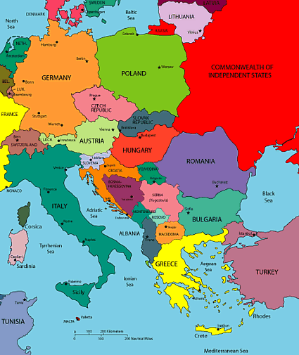
Historical Background
Bosnia and Herzegovina was one of the six republics constituting the Socialist Federal Republic of Yugoslavia
Three ethnic groups: Bosniaks (Bosnian Muslims), Bosnian Serbs (Orthodox), and Bosnian Croats (Catholics)

Slide 6
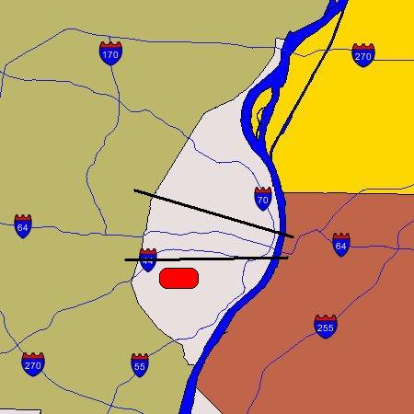
City of St Louis
North St Louis
primarily a Black population
Central Corridor
mixed Black & White population
Area where the Bosnian population is concentrated. Referred to as “Little Bosnia”
South St Louis
primarily a White population

Slide 7
Why Study Bosnians in St. Louis
St. Louis, MO was specified as one of the preferred communities
Low housing cost, less competition over low wage jobs
About 70,000 Bosnians (over 20% of the population of the city)

Slide 8
Why Study Bosnians in St. Louis (continued)
Most of the Bosnians are literate in their own language
Average educational level is high school
Much of the population experiences the language barrier
Older Bosnians rely on younger community members for translation

Slide 9
Studies on Bosnians in the U.S.
Existing studies focus on mental illness of Bosnian refugees
Being refugee does not necessarily imply low psychological well-being (Van Selm 1997)
Bosnians in the US do not have a fear of possible expulsion unlike Bosnians in some European countries.
Need to integrate refugees socio-cultural aspects to study resettlement process

Slide 10
Five Difficulties of Surveying
Bosnian Refugees
Conceptualization of research topic
Operationalization of concepts and validity of scales
Translation of questionnaires
Recruitment of subjects and gaining trust
Administering the questionnaire

Slide 11
Conceptualization of the Research Topic
Very few studies on Bosnian refugees in the late 1990’s
Results of the studies with Cuban and Vietnamese refugees do not apply to Bosnian refugees
Bosnians are Europeans
Most of the Bosnians in St. Louis are Muslims

Slide 12
Conceptualization of the Research Topic (continued)
Sequential exploratory method was used as a design (Obtain necessary information from qualitative data, then conduct a survey)
This is juxtaposed to the sequential explanatory method that uses a survey first, then obtains qualitative data for explanation of the findings

Slide 13
Conceptualization of the Research Topic (continued)
Grounded theory method was used for qualitative data collection for conceptualization
Interviews with 38 Bosnian refugees, 10 service providers at local, state, and federal refugee resettlement agencies
Observations with 6 Bosnian families
The sample size for qualitative data collection was determined by a theoretical saturation (Glazer and Strauss, 1962)

Slide 14
Conceptualization of the Research Topic (continued)
Concepts emerged from the qualitative data
Comfort (finding an emotional niche)
Competence (finding a material niche)
Sense of coherence (Antonovsky 1979)
Locus of control
Spiritual healing
Social support
Experience of discrimination

Slide 15
Operationalization of the concepts and validity of Scales
Environmental and historical variables need to be studied (Gansalves 1992)
Scales developed for general populations need to be validated
20 experts were selected for the content validity test
Selected scales to measure the constructs did not meet the standard suggested by Lynn (1986) and Davis (1997)

Slide 16
Operationalization of the concepts and validity of Scales
The results of the content validity test were different among academic experts, those from resettlement agencies, and those from the Bosnian community
A focus group of selected experts was conducted
The reliability test of the data collected from the survey was high (0.70-0.85)
No multicollinearity yet large R-squares

Slide 17
Translation of questionnaires
Conventional method is to back-translate the survey
Back-translation does not apply for words and phrases which have cultural uniqueness
In St. Louis, very few good translators in Bosnian and English
IRB officials started to realize the lack of efficacy of back-translation

Slide 18
Translation of questionnaires continued
The Bosnian survey was translated from English to Bosnian
Another professional translator carefully examined the Bosnian survey without back-translation
Several Bosnian refugees assessed the survey questionnaire
The final version of the Bosnian survey was proofread by the first translator

Slide 19
Recruitment of subjects and gaining trust
Difficulty of establishing a sampling frame
Problem of the use of a convenience sampling from religious organizations - many Bosnian refugees are cultural Muslims
Difficulty of gaining trust and entering the community – refugees are more suspicious about others than the general populations

Slide 20
Recruitment of subjects and gaining trust continued
Spending time in the community through a field work of the sequential exploratory method to gain trust
Having informants from the refugee community on the research team – establish liaisons between the researchers and the community
Use of several methods for recruitment (through network and other researchers, advertising)

Slide 21
Administering the questionnaire
Face-to-face interviews by qualified researchers who are fluent in English and Bosnian was not applicable due to shortage of qualified people
Internet survey is not appropriate for the refugee populations
The Bosnian project used a mail survey with incentives through mixed mode data collection.
The design of the questionnaire is important – size, font, color, etc.

Slide 22
Recommendations
Grounded theory method for conceptualization
Use of focus groups for content validity test
Cross-cultural validation of a translated questionnaire
Relationship between researchers and the refugee community

Slide 23

Questions and/or Comments?

